Slide 1
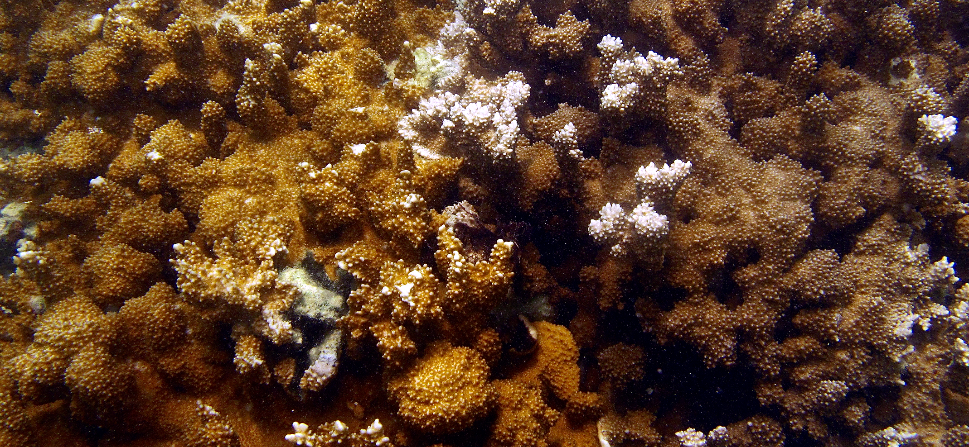
Spatial Distribution of Symbiodinium in Montipora capitata Across Kāne‘ohe Bay, O‘ahu, Hawai‘i
Teegan Innis¹, Ross Cunning², Raphael Ritson-Williams², Chris Wall², Ruth D. Gates²

Slide 2
Questions
What variability exists in the symbiont community of M. capitata in Kāne‘ohe Bay?
Is the symbiont community composition different between color morphs?
At what environmental scale do we see the largest variation in the symbiont community?
Notes:
Leveraging Ross’s paper looking at symbiont community differences in bleached colonies – all bleached colonies C, non-bleached colonies C and D, all D nonbleached – what is the distribution of symbionts across the bay?
2 distinct color morphs (brown and orange)

Slide 3
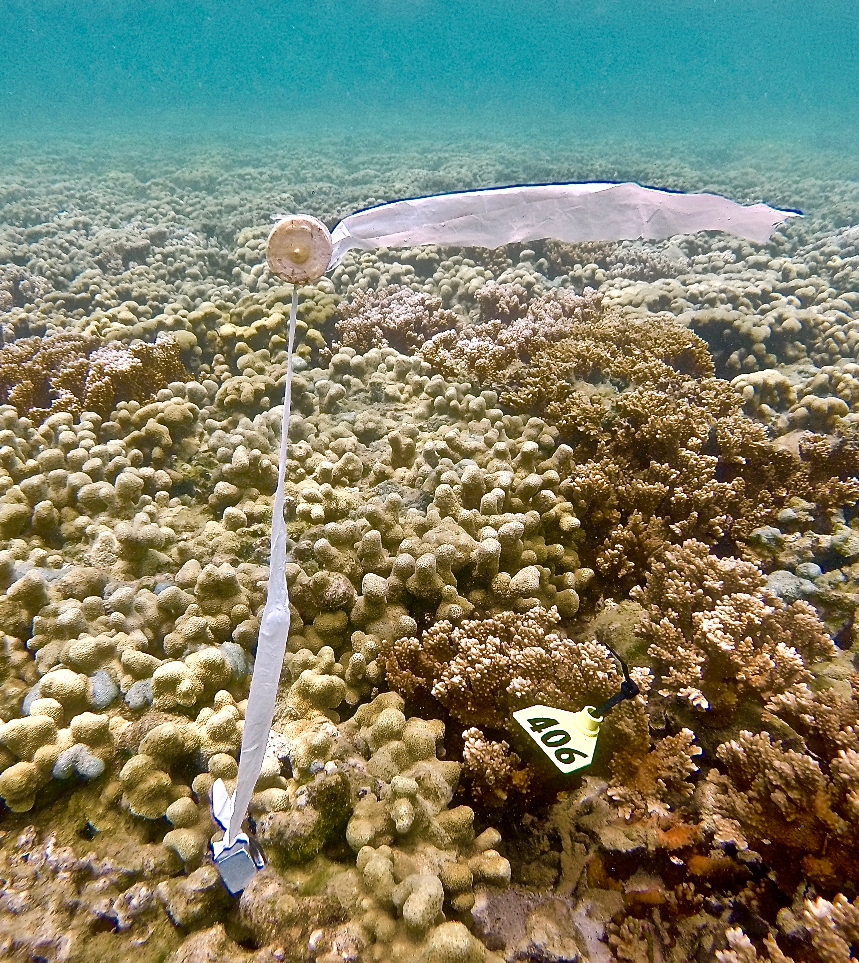
Methods
Tag, sample and photograph colonies in different habitats
Visual assignment of color morph
Quantitative PCR Clade C:D ratio
Notes:
30 colonies from each patch and 20 from each fringe
qPCR looking simply at dominance of C or D and relative ratio of C:D in each colony

Slide 4
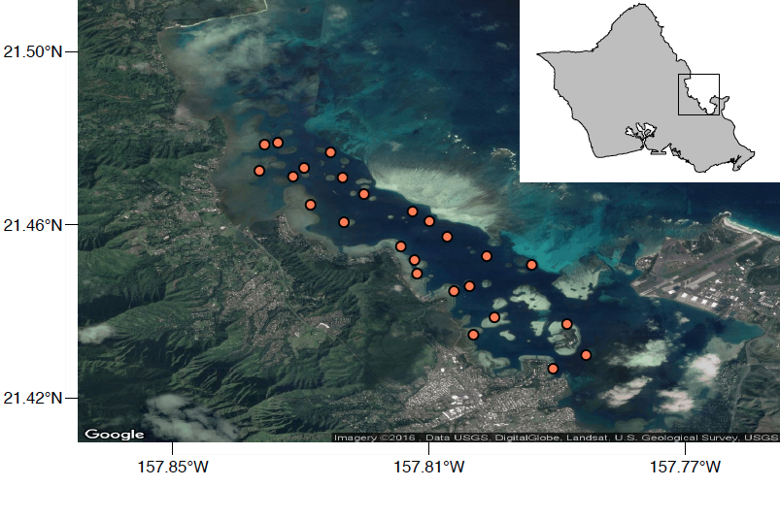
Notes:
16 patch reefs, 9 fringe reefs for a total of 25 sites – 707 total colonies
Side note: impetus for this project was to have a large sample of tagged corals throughout the bay – all colonies tagged with GPS, color assignment, symbiont composition/dominant symbiont, region of bay, reef type, etc. to be used in future monitoring/analyses – will be making spreadsheet – every colony has biopsy sitting in buffer and fragment archived in -80

Slide 5
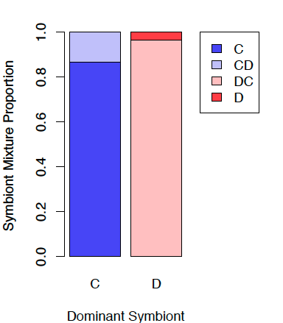
Clade C – 98.7%
Clade D – 46.8%
53% exclusively clade C
1.3% exclusively clade D
45.7% mixture
Notes:
9 colonies D-only – high Ct values (>35 of 40 cycles) even after re-extraction and run through another qPCR and C present in 1 technical replicate in 5 colonies – perhaps D is never exclusive but levels of C association are extremely low?

Slide 6
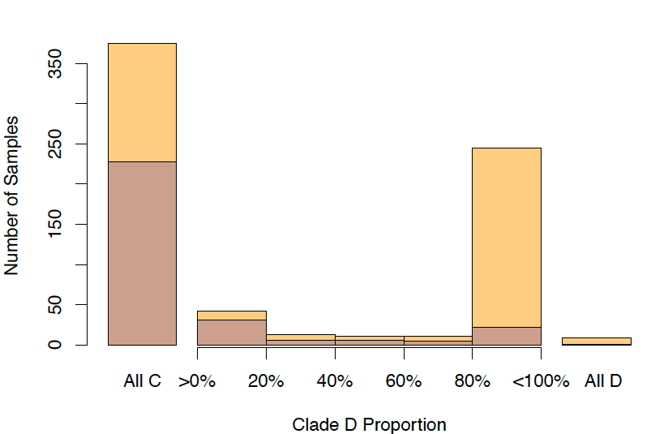
Notes:
C dominant in 61% colonies
86.6% C-dominated were exclusively C, 3.3% D-dominated were exclusively D
C-dominance in 89% brown colonies, D-dominance in 59% orange colonies
When D present, typically in abundance >80% indicating D-dominated colony

Slide 7
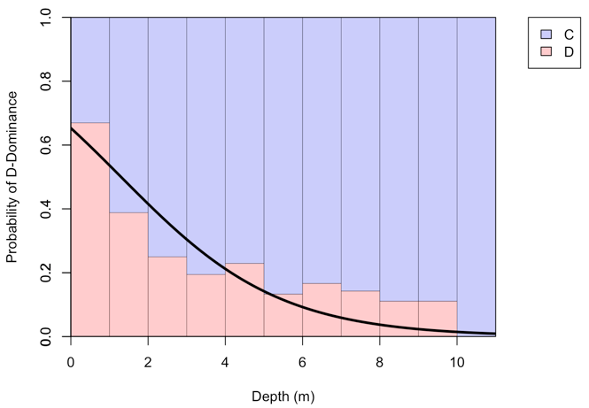
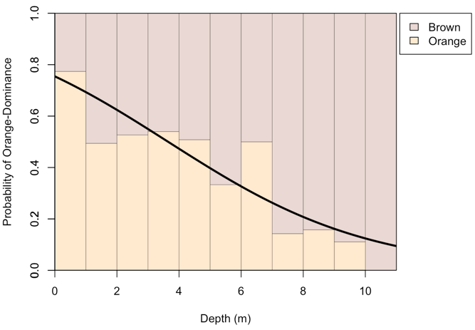
Depth Distributions
Notes:
Significant driving factor for both symbiont dominance and color morph
Bars indicate relative frequency of symbiont dominance and color morph at 1m depth intervals when pooling all samples
Threshdeph C/D=1.29m
Threshdepth Brown/Orange= 3.64m
Both thresholds obviously vary at each individual reef, but not significantly

Slide 8
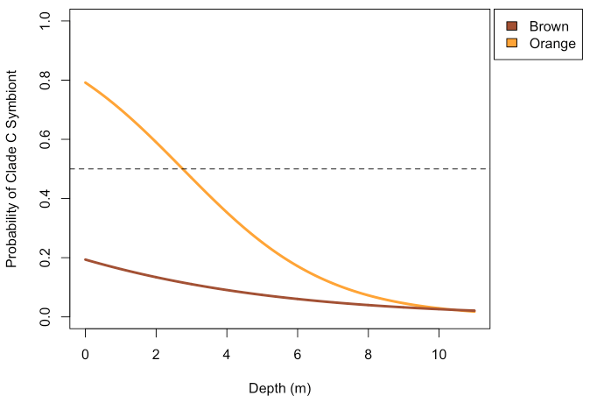
Brown always more likely to be clade C-dominated
Depth threshold at 2.75m in orange color morph
Notes:
Again, threshold varies at each individual reef, yet not significantly

Slide 9
Mahalo!

